Slide 1
Scientific Programming Practical 2
Introduction
Luca Bianco - Academic Year 2017-18
luca.bianco@fmach.it

Slide 2

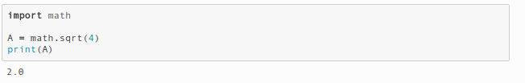
Modules and Objects
Modules are text files with .py extension
Import modules to use them
Objects
“Objects are Python’s abstraction for data. All data in a Python program is represented by objects or by relations between objects.”
IDENTIFIER
TYPE
MUTABLE
VALUE
IMMUTABLE

Slide 3
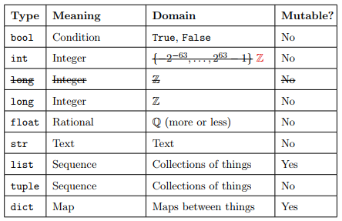
Built-in data types

Slide 4
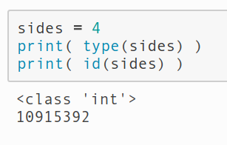
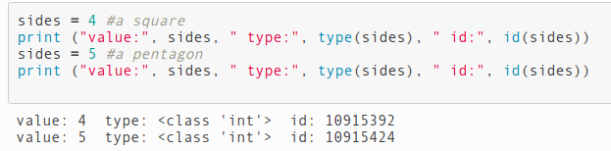
Variable assignment
What happens when we…
>>> sides = 4
A new object is created and the
name ‘sides’ points to it
ID:10915392
type: INT
value: 4
INT is immutable, therefore:

Slide 5
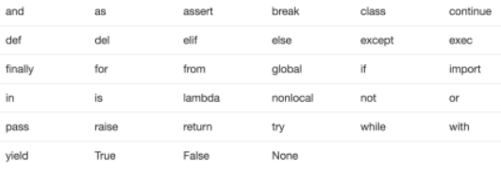
Name of variables
You can choose the name you like but:
Can only contain A-Z, a-z, 0-9 or _
Cannot start with a number
Cannot be one of the reserved words

Slide 6
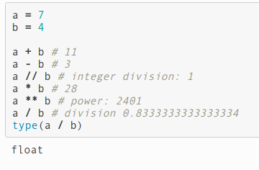
Integers
As one would expect...
REMEMBER: Immutable
Their range limited by the memory available only

Slide 7
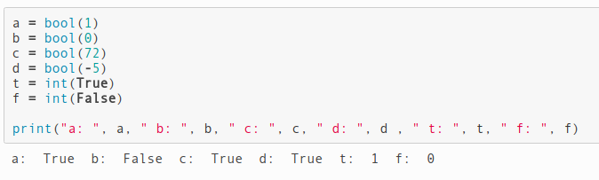
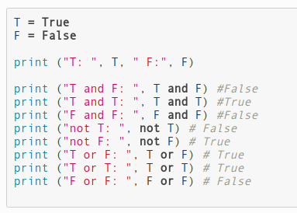
Booleans
Assume only values True and False
Boolean algebra rules...
All numbers evaluate to True except 0.

Slide 8
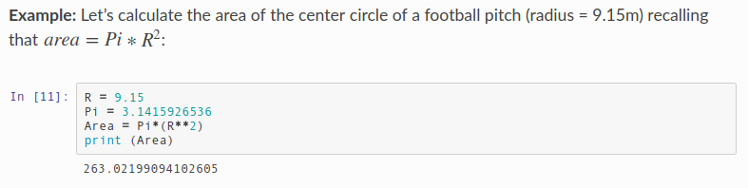
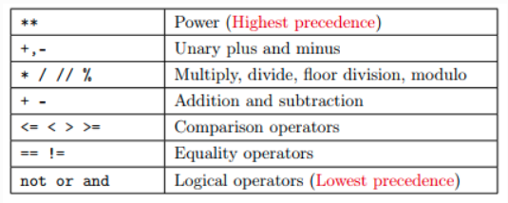
Reals
In python they are floating points (floats)
Use parenthesis or remember precedence of operators...

Slide 9
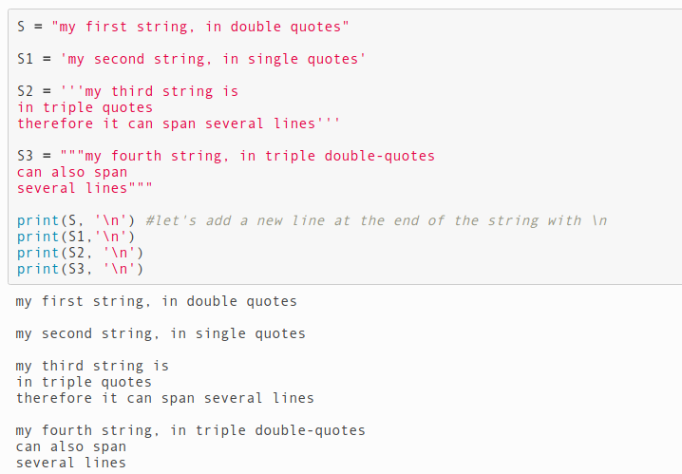
Strings
In python they are immutable objects to deal with text

Slide 10
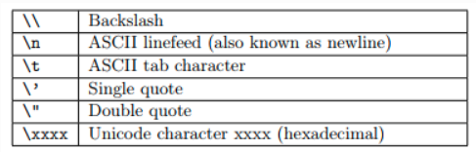

Strings
Escape special characters

Slide 11
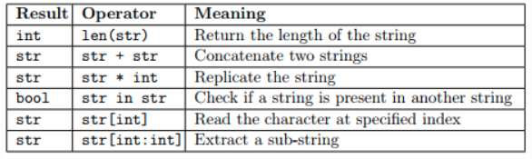
Strings
Functions

Slide 12
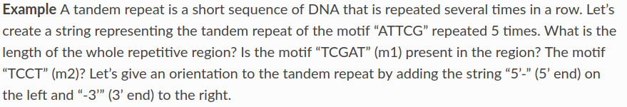
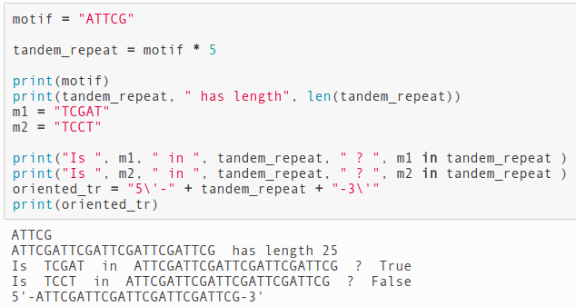
Strings

Slide 13
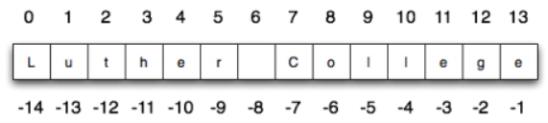
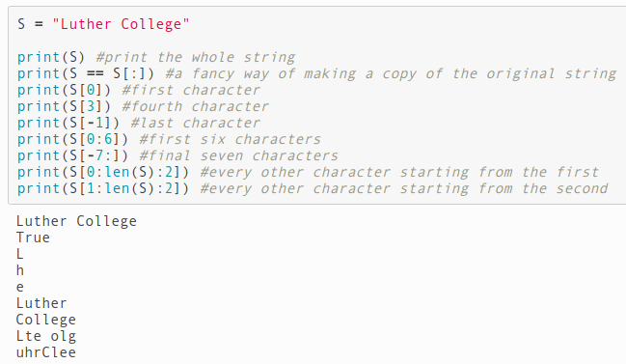
Strings
Indexing and Slicing
Indexing starts from 0
str[i] : i+1-th character
str[S:E:step] slice string
Remember: S inclusive, E exclusive

Slide 14
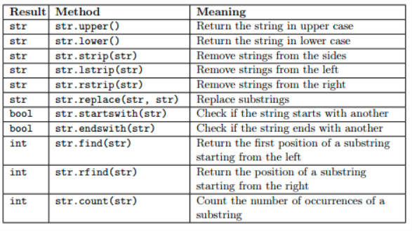
Strings
Methods

Slide 15
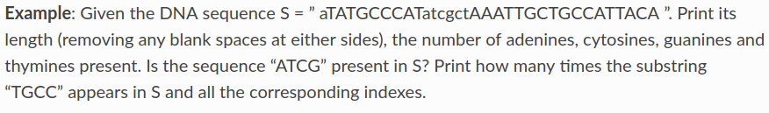
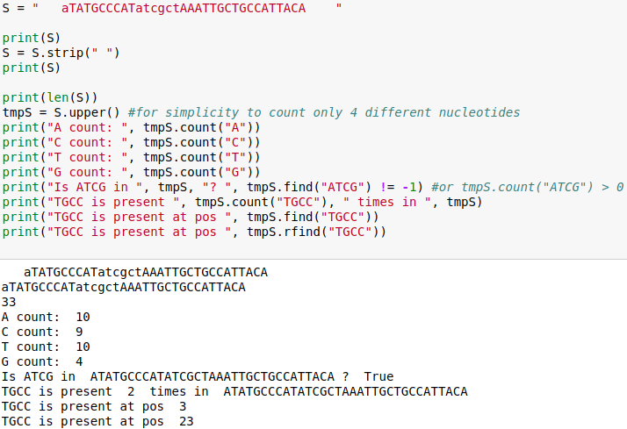
Strings

Slide 16
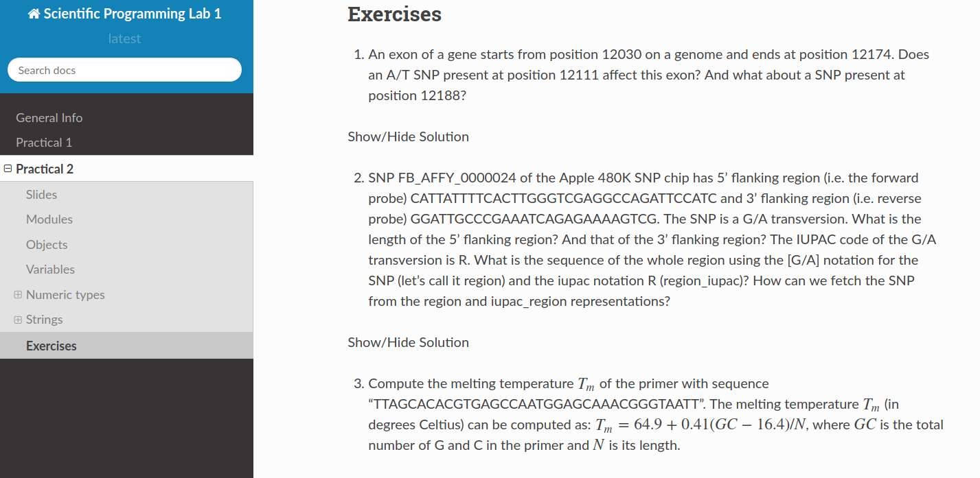
http://sciprolab1.readthedocs.io/en/latest/practical2.html

